Slide 1


Applied Digital Logic Design
(EC1002-2)
Department of E&CE
N.M.A.M. Institute of Technology, Nitte

Slide 2
Outline
Syllabus
Difference between Analog and Digital Signals
Number Systems
Basic and Universal gates
Boolean algebra
Introduction to Combinational Logic
02

Slide 3
Syllabus
03

Slide 4
Syllabus
UNIT – I
Fundamentals of Digital Design: Difference between Analog and Digital Signals, Number Systems: Decimal, Binary, Octal and Hexadecimal. Binary Addition and Subtraction, Digital Logic Gates, Boolean Algebra, Boolean Functions: Canonical Forms, Completely and Incompletely Specified Functions, Simplification of Boolean Functions using Boolean Algebra, Karnaugh Map and Quine-McCluskey Method, Realization of Boolean functions using Basic Gates and Universal Gates. 10Hrs
4

Slide 5
UNIT – II
Combinational Logic and Sequential Logic Circuits: Introduction to Combinational Logic Circuits, Half/Full Adders/Subtractors, Parallel Adders/Subtractors, Binary Comparators, Decoders, Encoders, Multiplexers. Basic Bistable Element, SR Flip-Flop, D Flip Flop, JK Flip Flop, T Flip Flop, Master Slave JK Flip Flop, Characteristic Equations, Conversion of Flip Flops.
10Hrs
5

Slide 6
Syllabus
UNIT – III
Applications of Flip Flops: Design of Shift Register using D- flip flop, Design of Counters: Asynchronous counters using T-flip flop, Synchronous Counters using D-flip flop and T Flip Flop 5Hrs
6

Slide 7
Course Outcomes
CO1 Compare Analog and Digital Signals; Convert the number from one numbering system to another;
CO2 Simplify the logic expressions using Boolean Algebra or K-Map or QM Method; Realize the logic expression using Basic/Universal Gates;
CO3 Analyze and Design different Combinational logic circuits such as Decoders, Encoders, Multiplexers, Adders, Subtractors, Binary Comparators
CO4 Describe the operation of Latches, Flip flops, Mater-Slave Flip flops, Edge triggered Flip-flops.
CO5 Make use of Flip flops to design Registers, Synchronous/Asynchronous Counters.
7

Slide 8
Text Books
T1 Morris Mano, "Digital Design", Prentice Hall of India, Third Edition.
T2 Donald D. Givone, “Digital Principles and Design”, Tata McGraw Hill, 2002.
8

Slide 9
Reference Books
R1 John M Yarbrough, "Digital Logic Applications and Design", Thomson Learning,
2001.
R2 D. P. Kothari and J. S Dhillon, "Digital Circuits and Design’, Pearson, 2016.
R3 Charles H Roth, "Fundamentals of Logic Design", Cengage Learning.
9

Slide 10
NPTEL/ MOOC Links
https://nptel.ac.in/courses/117106086
10

Slide 11
Evaluation Criteria
Assessment Weightage in Marks(Theory)
Mid Semester Exam 1 (MSE1) | 20
Mid Semester Exam 2 (MSE2) | 20
Tasks (4+4+2) | 10
Total | 50
60% weightage, converted to 30 Marks, passing Marks :12
11

Slide 12
Evaluation Criteria
Assessment Weightage in Marks(Practical)
Record | 10
Task/Performance | 10
MSE | 30
Total | 50
40% weightage, converted to 20 Marks, passing Marks :8 | 100
12

Slide 13
Unit 1 Fundamentals of Digital Design

Slide 14
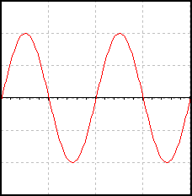
Digital and Analog Basic Concepts: Analog Signals
Amplitude
Distance above reference line
Cycle
One complete wave
Frequency
Cycles per second .Hertz is the unit used for expressing
frequency. Frequency:
F = ¹ Hz
T
Period
(T)
Amplitude
(peak)
Amplitude
(peak-to-peak)
14

Slide 15
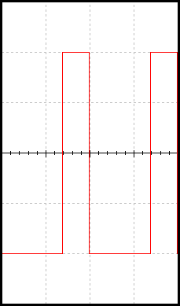
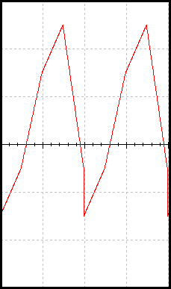
Example of Analog Signals
An analog signal can be any time-varying signal.
Minimum and maximum values can be either positive or negative.
They can be periodic (repeating) or non-periodic.
Sine waves and square waves are two common analog signals.
Note that this square wave is not a digital signal because its minimum value is negative.
0 volts
Sine Wave
Square Wave
(not digital)
Random-Periodic
3

Slide 16
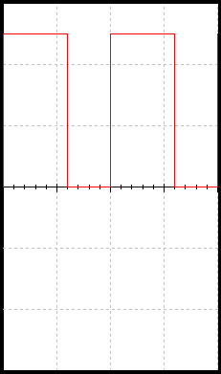
Digital and Analog Basic Concepts: Digital Signals
Amplitude:
For digital signals, this will ALWAYS be 5volts.
Period:
The time it takes for a periodic signal to repeat. (seconds)
Frequency:
A measure of the number of occurrences of the signal per second. (Hertz, Hz)
Time High (t_{H}):
The time the signal is at 5 v.
Time Low (t_{L}):
The time the signal is at 0 v.
Duty Cycle:
The ratio of t_{H} to the total period (T).
Rising Edge:
A 0-to-1 transition of the signal.
Falling Edge:
A 1-to-0 transition of the signal.
Amplitude
Period (T)
Frequency:
F = ¹ Hz
DutyCycle = ^{tH} ×100%
T
T
16

Slide 17
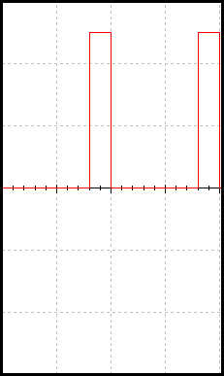
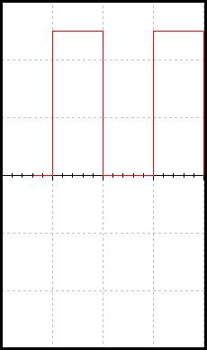
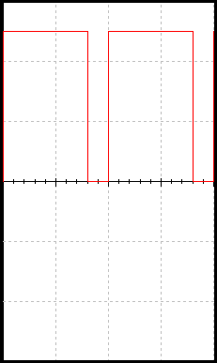
Example of Digital Signals
Digital signal are commonly referred to as square waves or clock signals.
Their minimum value must be 0 volts, and their maximum
value must be 5 volts.
They can be periodic (repeating) or non-periodic.
The time the signal is high (t_{H}) can vary anywhere from 1% of the period to 99% of the period.
5 volts
0 volts
17

Slide 18
Differences of Analog and Digital Signals
Analog Signals Digital Signals
Continuous both time and amplitude
Infinite range of values
Discrete in time and quantized in amplitude
Finite range of values
Not as exact as analog, but easier to work with
More exact values, but
more difficult to work with
Storing requires memory
such a signal large
Storing requires memory
such less
a signal amount of
amount of
Processing requires large processing power or more time
Processing requires low
less
processing power or time
Transmitting requires a
Transmitting requires a less bandwidth than analog
6
large bandwidth

Slide 19
Number Systems
A number system defines how a number can be represented using distinct symbols.
The number the numeral represents is called its value.
A number can be represented differently in different systems
For example, the two numbers (2A)₁₆ and (52)₈ both refer to the same quantity, (42)₁₀, but their representations are different
19

Slide 20
Common Number Systems
Four number system
Decimal (10) , Binary (2), Octal (8) and Hexadecimal(16)
System | Base | Symbols | Used by humans? | Used in computers?
Decimal | 10(D) | 0, 1, … 9 | Yes | No
Binary | 2(B) | 0, 1 | No | Yes
Octal | 8(O) | 0, 1, … 7 | No | No
Hexa- decimal | 16(H) | 0, 1, … 9, A, B, … F | No | No
20

Slide 21
Decimal numbers
In the decimal number systems each of the ten digits, 0 through 9,
represents a certain quantity also known as base-10 number systems
The position of each digit in a decimal number indicates the magnitude of the quantity represented and can be assigned a weight. The weights for whole numbers are positive powers of ten that increases from right to left, beginning with 10º = 1
For fractional numbers, the weights are negative powers of ten that decrease from left to right beginning with 10⁻¹.
21

Slide 22
Decimal numbers
Base
10^4 10^3 10^2
10000 1000 100 10
10^1
10^0
10^-1 10^-2 10^-3
0.1 0.01 0.001
1
left of the decimal point
Right of decimal point
10

Slide 23
Decimal numbers
Example: the value 725.194 is represented in expansion form as follows:
7 * 10^2 + 2 * 10^1 + 5 * 10^0 + 1 * 10^-1 + 9 * 10^-2 + 4 * 10^-3
= 7 * 100 + 2 * 10 + 5 * 1 + 1 * 0.1 + 9 * 0.01 + 4 * 0.001
= 700 + 20 + 5 + 0.1 + 0.09 + 0.004
= 725.194
11

Slide 24
Binary Numbers
Most modern computer system using binary logic. The computer represents values(0,1) using two voltage levels (usually 0V for logic 0 and either +3.3 V or +5V for logic 1).
The Binary Number System uses base 2 includes only the digits 0 and 1 . The position of a 1 or 0 in a binary number indicates its weight, or value within the number, just as the position of a decimal digit determines the value of that digit.
With 4 digits position we can count from zero to 15. In general, with n bits we can count up to a number equal to 2ⁿ - 1.
Largest decimal number = 2^{𝑛}- 1
12

Slide 25
Binary Numbers
A binary number is a weighted number. The right-most bit is the least significant bit (LSB) in a binary whole number and has a weight of 2º =1. The weights increases from right to left by a power of two for each bit. The left-most bit is the most significant bit (MSB); its weight depends on the size of the binary number.
The weighted values for each position are :
2^5 2^4 2^3 2^2 2^1 2^0
16 8 4 2 1
Base
2^-1
2^-2
32
0.5 0.25
left of the radix point
Right of radix point
13

Slide 26
Octal Systems
Computer scientists are often looking for shortcuts to do things
One of the ways in which we can represent binary numbers is to use their octal equivalents instead
This is especially helpful when we have to do fairly complicated tasks using numbers
The octal system is composed of eight digits, Known as base-8 number systems which are: 0, 1, 2, 3, 4, 5, 6, 7
To count above 7, begin another column and start over: 10, 11, 12, 13, 14, 15, 16, 17, 20, 21 and so on.
Counting in octal is similar to counting in decimal, except
14
that the digits 8 and 9 are not used.

Slide 27
Hexadecimal Numbers
The hexadecimal number system has sixteen digits and is used primarily as a compact way of displaying or writing binary numbers because it is very easy to convert between binary and hexadecimal.
Long binary numbers are difficult to read and write because it is easy to drop or transpose a bit. Hexadecimal is widely used in computer and microprocessor applications.
The hexadecimal system known as base-16 number systems,
It is composed of 16 digits and alphabetic characters, which are: 0, 1, 2, 3, 4, 5, 6, 7, 8, 9, A, B, C, D, E, F
To count above 16, begin another column and start over:
10, 11, 12, 13, 14…. 1D, 1E, 1F, 20, 21 and so on
The maximum 3-digits hexadecimal number is FFF or decimal 4095 and maximum 4-digit hexadecimal number is FFFF or decimal 65,535

Slide 28
Number Representation in different systems
Quantities/Counting (1 of 3)
Decimal | Binary | Octal | Hexa- decimal
0 | 0 | 0 | 0
1 | 1 | 1 | 1
2 | 10 | 2 | 2
3 | 11 | 3 | 3
4 | 100 | 4 | 4
5 | 101 | 5 | 5
6 | 110 | 6 | 6
7 | 111 | 7 | 7

Slide 29
Number Representation in different systems
Quantities/Counting (2 of 3)
Decimal | Binary | Octal | Hexa- decimal
8 | 1000 | 10 | 8
9 | 1001 | 11 | 9
10 | 1010 | 12 | A
11 | 1011 | 13 | B
12 | 1100 | 14 | C
13 | 1101 | 15 | D
14 | 1110 | 16 | E
15 | 1111 | 17 | F

Slide 30
Number Representation in different systems
Quantities/Counting (3 of 3)
Decimal | Binary | Octal | Hexa- decimal
16 | 10000 | 20 | 10
17 | 10001 | 21 | 11
18 | 10010 | 22 | 12
19 | 10011 | 23 | 13
20 | 10100 | 24 | 14
21 | 10101 | 25 | 15
22 | 10110 | 26 | 16
23 | 10111 | 27 | 17
Etc.

Slide 31
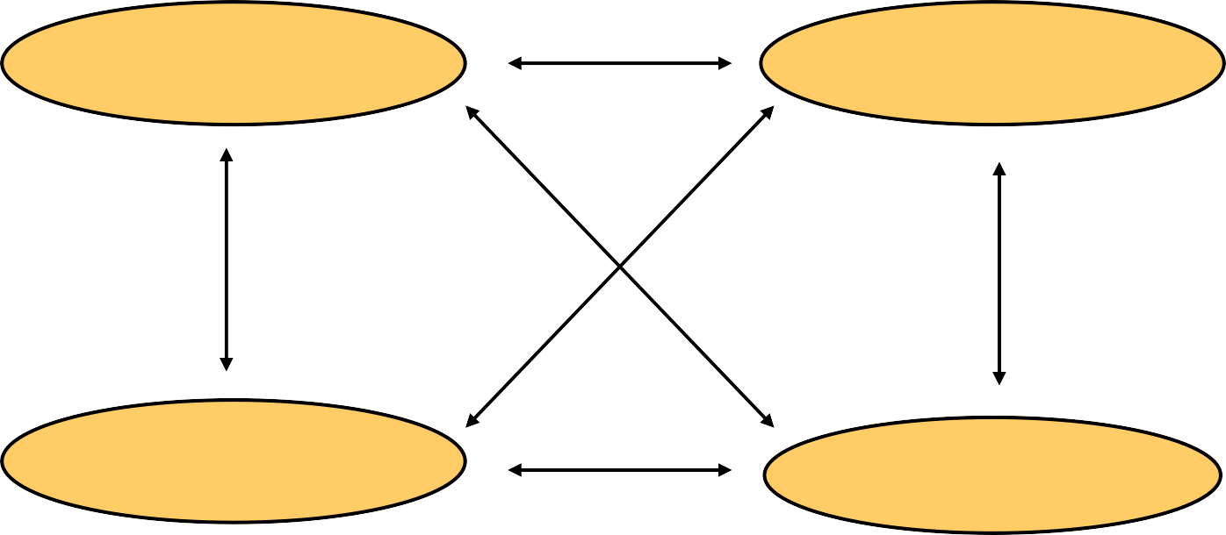
Number System Conversions
The possibilities:
Decimal
Octal
Binary
Hexadecimal

Slide 32
Quick Example
25₁₀ = 11001₂ = 31₈ = 19₁₆
Base

Slide 33
Decimal to Decimal
Decimal
Octal
Binary
Hexadecimal

Slide 34
Decimal to decimal
Weight
125₁₀ => 5 x 10⁰ = 5
2 x 10¹ = 20
1 x 10²
= 100
125
Base

Slide 35
Fractions
3.14 =>
4 x 10⁻²
1 x 10⁻¹
3 x 10⁰
= 0.04
= 0.1
= 3
3.14

Slide 36
Binary to Decimal
Decimal
Octal
Binary
Hexadecimal

Slide 37
Binary to Decimal
Technique
Multiply each bit by 2^{n}, where n is the “weight” of the bit
The weight is the position of the bit, starting from 0 on the right
Add the results

Slide 38
Example
Bit “0”
₂0
₂1
₂2
₂3
₂4
₂5
101011₂ | => | 1 | x
 |  | 1 | x
 |  | 0 | x
 |  | 1 | x
 |  | 0 | x
 |  | 1 | x
= | 1
= | 2
= | 0
= | 8
= | 0
= 32
43₁₀

Slide 39
Binary to Decimal
1101 = 1 x 2³ + 1 x 2² + 0 x 2¹ + 1 x 2⁰
= 1 x 8 + 1 x 4 + 0 x 2 + 1 x 1
= 8 + 4 + 0 + 1
(1101)₂ = (13)₁₀
1, 2, 4, 8, 16, 32, 64, 128, 256, 512, ….

Slide 40
Binary to decimal (Fractions)
₂-4
₂-3
₂-2
₂-1
₂0
₂1
2.6875
10.1011 | => | 1 | x
 |  | 1 | x
 |  | 0 | x
 |  | 1 | x
 |  | 0 | x
 |  | 1 | x
= | 0.0625
= | 0.125
= | 0.0
= | 0.5
= | 0.0
= | 2.0

Slide 41
Octal to Decimal
Decimal
Octal
Binary
Hexadecimal

Slide 42
Octal to Decimal
Technique
Multiply each bit by 8^{n}, where n is the “weight” of the bit
The weight is the position of the bit, starting from 0 on the right
Add the results

Slide 43
Example
₈0
₈1
₈2
724₈ | => | 4 | x
 |  | 2 | x
 |  | 7 | x
= | 4
= | 16
= | 448
 | 468₁₀

Slide 44
Octal to Decimal
137 = 1 x 8² + 3 x 8¹ + 7 x 8⁰
= 1 x 64 + 3 x 8 + 7 x 1
= 64 + 24 + 7
(137)₈ = (95)₁₀
Digits used in Octal number system – 0 to 7

Slide 45
Hexadecimal to Decimal
Decimal
Octal
Binary
Hexadecimal

Slide 46
Hexadecimal to Decimal
Technique
Multiply each bit by 16^{n}, where n is the “weight” of the bit
The weight is the position of the bit, starting from 0 on the right
Add the results

Slide 47
Example
ABC₁₆ | =>C | x | 16⁰ | = | 12 | x | 1 | = | 12
 | B | x | 16¹ | = | 11 | x | 16 | = | 176
 | A | x | 16² | = | 10 | x | 256 | = | 2560
2748₁₀

Slide 48
Hex to Decimal
BAD = 11 x 16² + 10 x 16¹ + 13 x 16⁰
= 11 x 256 + 10 x 16 + 13 x 1
= 2816 + 160 + 13
(BAD)₁₆ = (2989)₁₀
A = 10, B = 11, C = 12, D = 13, E = 14, F = 15

Slide 49
Number System Conversions
Decimal to Base-k [Successive division]
Divide the decimal number to be converted by ‘k’
The remainder from Step 1 is the least significant digit
Divide the quotient of the previous divide by the ‘k’
Record the remainder from Step 3 as the next digit
Repeat Steps 3 and 4, getting remainders from right to left, until the quotient becomes zero in Step 3.
The last remainder thus obtained will be the Most Significant Digit

Slide 50
Number System Conversions
Decimal to Base-k [Successive Multiplication]
Multiply the fractional decimal number, to be converted, by ‘k’
The integer from Step 1 is the highest order digit
Multiply the fractional part from Step 1 by the ‘k’
Record the integer from Step 3 as the next digit
Repeat Steps 3 and 4, getting integers from left to right, until the fractional part becomes zero in Step 3.

Slide 51
Decimal to Binary
Decimal
Octal
Binary
Hexadecimal

Slide 52
Example
125₁₀ = ?₂
2 125
2
2
2
2
2
2
62 1
31 0
15 1
7 1
3 1
1 1
0 1
125₁₀ = 1111101₂

Slide 53
Decimal to Binary
2
2
2
2
 | 13
 | 6
 | 3
 | 1
 | 0
LSB
1
0
1
1
MSB
(13)₁₀ = (1101)₂

Slide 54
Fractions
Decimal to binary
.14579
x 2 0.29158
x 2
0.58316
x 2 1.16632
x 2
0.33264
x 2 0.66528
x 2 1.33056
etc.
3.14579
11.001001...

Slide 55
Decimal to Octal
Decimal
Octal
Binary
Hexadecimal

Slide 56
Example
1234₁₀ = ?₈
8 1234
8
8
8
154 2
19 2
2 3
0 2
1234₁₀ = 2322₈

Slide 57
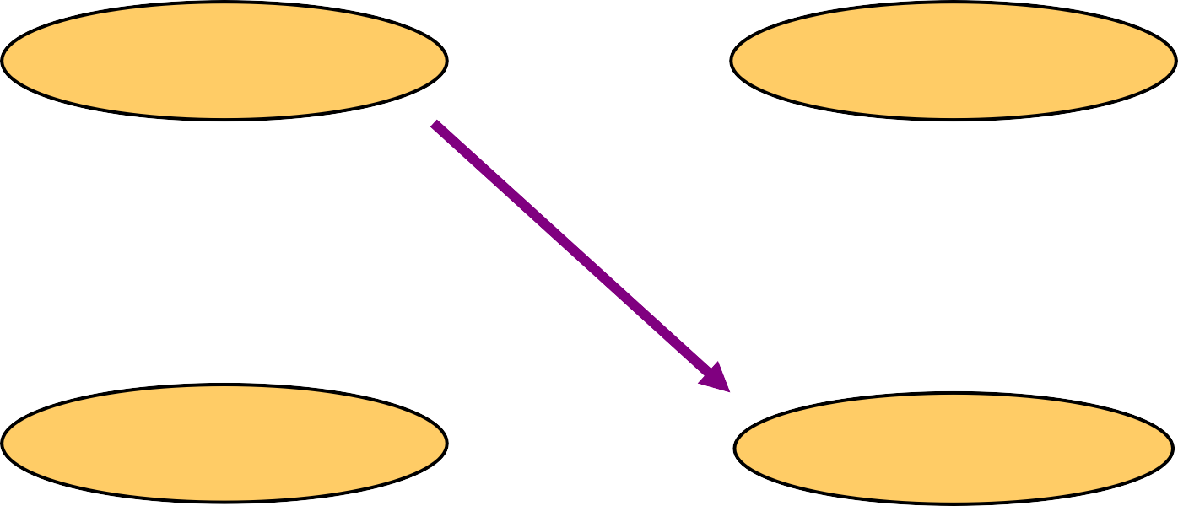
Decimal to Hexadecimal
Decimal
Octal
Binary
Hexadecimal

Slide 58
Example
1234₁₀ = ?₁₆
16 1234
16 77 2
₁₆ 4 13 = D
0 4
1234₁₀ = 4D2₁₆

Slide 59
Decimal to Hex
16
16
16
 | 2989
 | 186
 | 11
 | 0
LSP
13
10
11
MSP
(2989)₁₀ = (BAD)₁₆

Slide 60
Binary to Octal
Decimal
Octal
Binary
Hexadecimal

Slide 61
Binary to Octal
Technique
Binary to Octal [Integers]
Divide the binary digits into groups of three (starting from the right).
Convert each group of three binary digits to one octal digit
Binary to Octal [Fractions]
Divide the binary digits into groups of three (starting from the radix point).
Convert each group of three binary digits to one octal digit

Slide 62
Example
1011010111₂ = ?₈
1 | 011 | 010 | 111
1 | 3 | 2 | 7
1011010111₂ = 1327₈

Slide 63
Binary to Hexadecimal
Decimal
Octal
Binary
Hexadecimal

Slide 64
Binary to Hexadecimal
Technique
Binary to Hexadecimal [Integers]
Divide the binary digits into groups of four (starting from the right).
Convert each group of four binary digits to one hexadecimal digit
Binary to Hexadecimal [Fractions]
Divide the binary digits into groups of four (starting from the radix point).
Convert each group of four binary digits to one hexadecimal digit

Slide 65
Example
1010111011₂ = ?₁₆
10 1011 1011
2 B
B
1010111011₂ = 2BB₁₆

Slide 66
Octal to Hexadecimal
Decimal
Octal
Binary
Hexadecimal

Slide 67
Octal to Hexadecimal
Technique
Use binary as an intermediary

Slide 68
Example
1076₈ = ?₁₆
1 0
7
6
001 000 111 110
E
2
3
1076₈ = 23E₁₆

Slide 69
Hexadecimal to Octal
Decimal
Octal
Binary
Hexadecimal

Slide 70
Hexadecimal to Octal
Technique
Use binary as an intermediary

Slide 71
Example
1F0C₁₆ = ?₈
1 F
0
C
0001 1111 0000 1100
1
7 4
1F0C₁₆
1
4
= 17414₈

Slide 72
Octal to Binary
Decimal
Octal
Binary
Hexadecimal

Slide 73
Octal to Binary
Technique
Convert each octal digit to a 3-bit equivalent binary representation

Slide 74
Example
705₈ = ?₂
7
0
5
111 000
101
705₈ = 111000101₂

Slide 75
Hexadecimal to Binary
Decimal
Octal
Binary
Hexadecimal

Slide 76
Hexadecimal to Binary
Technique
Convert each hexadecimal digit to a 4-bit equivalent binary representation

Slide 77
Example
10AF₁₆ = ?₂
1 | 0 | A | F
0001 | 0000 | 1010 | 1111
10AF₁₆ = 0001000010101111₂

Slide 78
Decimal to Hex
(2989.56)₁₀ = (?)₁₆
16
16
16
 | 2989
 | 186
 | 11
 | 0
LSP
13
10
11
MSP
(2989)₁₀ = (BAD)₁₆

Slide 79
Fractions
Decimal to HEX
.56
x 16 8.96
x 16
15.36
x 16 5.76
x 16
12.16
x 16 2.56
x 16 8.96
etc.
2989.56
BAD.8F5C28

Slide 80
LOGIC GATES
A logic gate is an elementary building block of a digital circuit.
Logic gates can be created using transistor technology, that perform Boolean operations on high (5V) and low(0V) signals.
There are seven logic gates:
Basic gates: AND, OR and NOT
Universal gates: NOR and NAND
Other gates : XOR and XNOR

Slide 81
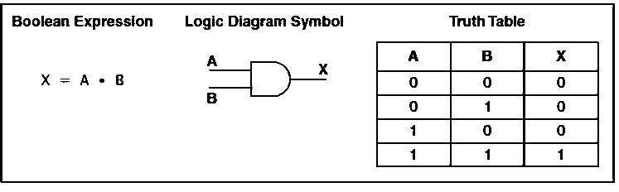
AND GATE
For AND gate, if both the inputs are 1 the output is 1; otherwise, the output is 0.

Slide 82
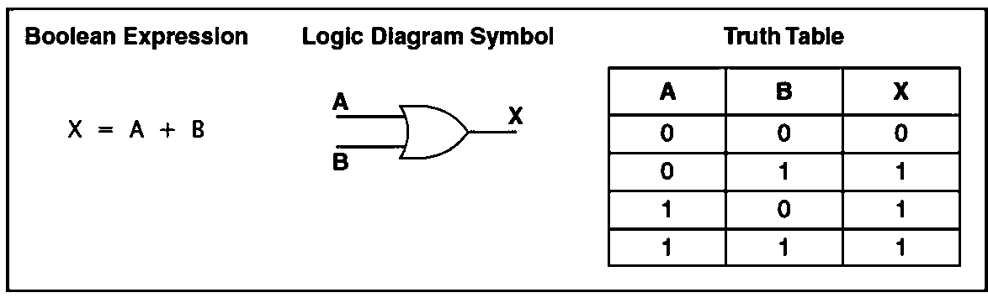
OR GATE
OR Gate: For OR gate, if both the inputs are 0 the output is 0; otherwise, the output is 1.

Slide 83
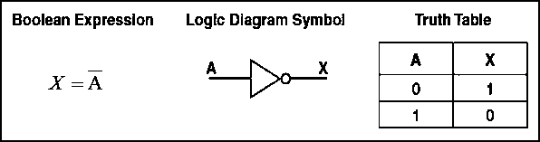
NOT GATE
NOT Gate: A NOT gate accepts one input signal (0 or 1) and returns the complementary (opposite) signal as output.

Slide 84
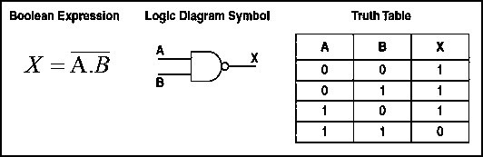
NAND GATE
NAND Gate: For NAND (“NOT of AND”) gate, if both the inputs are 1, the output is 0; otherwise, the output is 1.

Slide 85
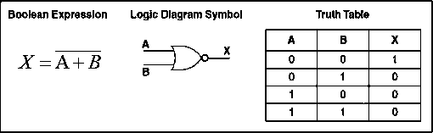
NOR GATE
NOR Gate: The NOR (“NOT of OR”) gate, if both the inputs are 0, the output is 1; otherwise, the output is 0.

Slide 86
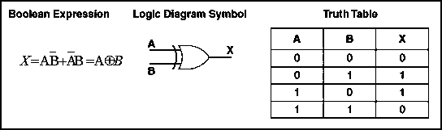
XOR GATE
XOR Gate: For XOR gate, if both the inputs are same, the output is 0; otherwise, the output is 1.

Slide 87
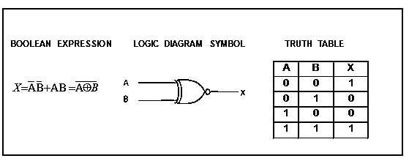
XNOR GATE
XNOR Gate: For XNOR gate, if both the inputs are same, the output is 1; otherwise, the output is 0.

Slide 88
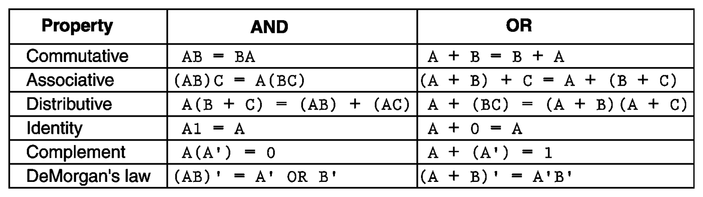
PROPERTIES OF BOOLEAN ALGEBRA

Slide 89
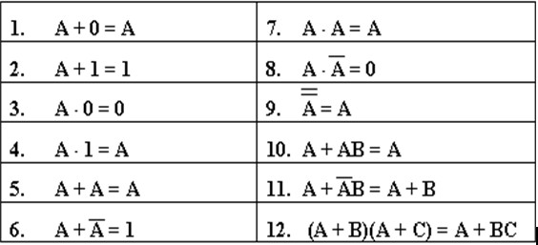
BASIC RULES OF BOOLEAN ALGEBRA

Slide 90
A+𝐴B = A.1 + 𝐴 B
Proof For A+𝐴 B = A+B
= A(1+B) + 𝐴 B
= A + AB + 𝐴 B
= A + B (A + 𝐴)

Slide 91
Proof For (A+B)(A+C) = A+BC
(A+B)(A+C) = A.A + A.C + B.A + B.C
= A + A.C + B.A + BC
= A(1+C)+ BA +BC
= A + BA + BC
= A(1+B) + BC
= A +BC

Slide 92
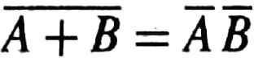
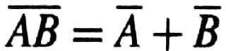
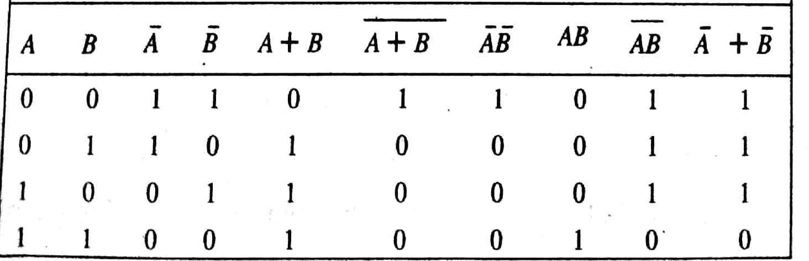
DeMorgan’s Theorems
(i)
(ii)

Slide 93
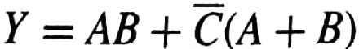
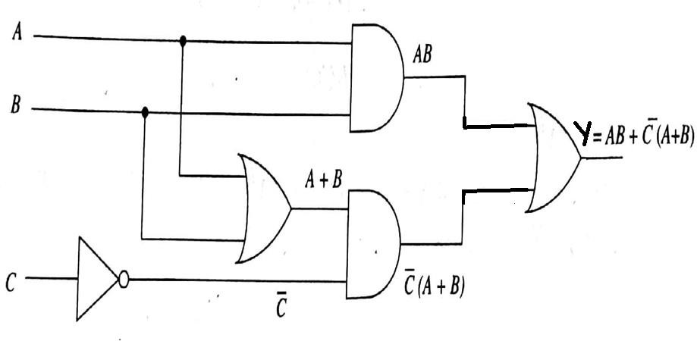
EXAMPLES
1. Implement the Boolean Expression using basic Gates

Slide 94
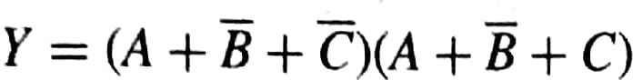
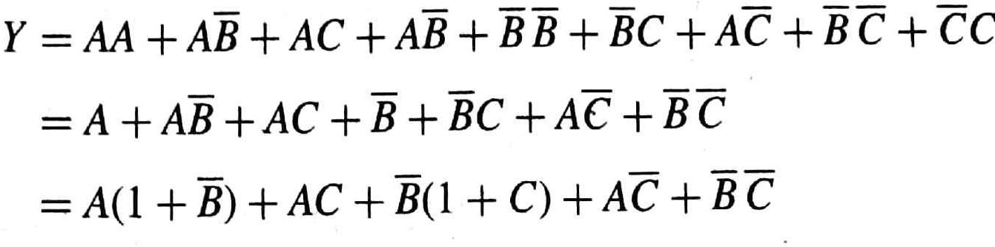
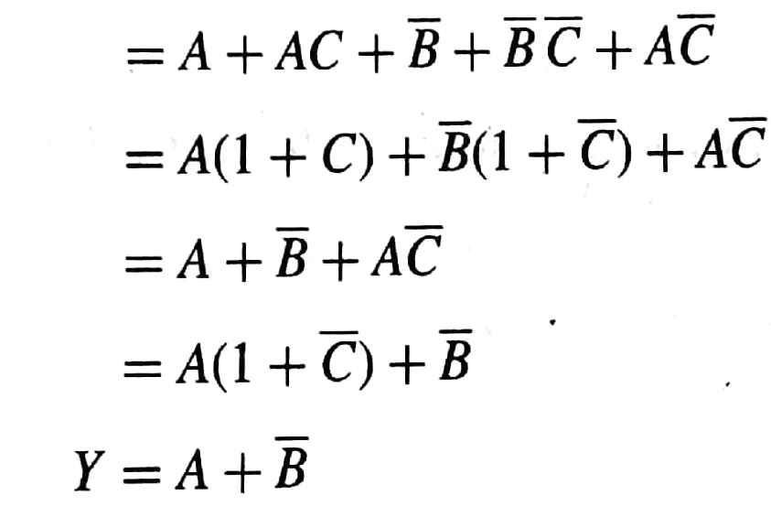
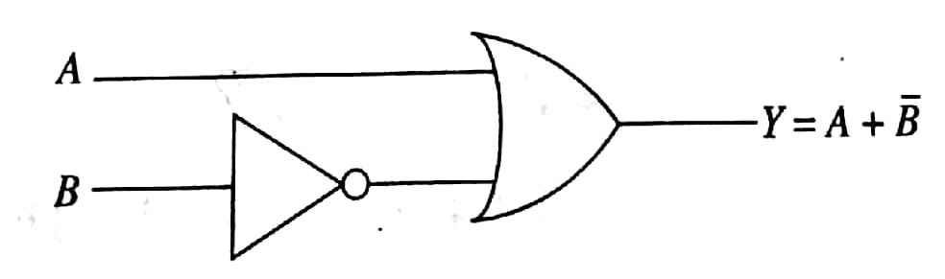
2. Simplify the boolean expression and realize using basic gates.

Slide 95
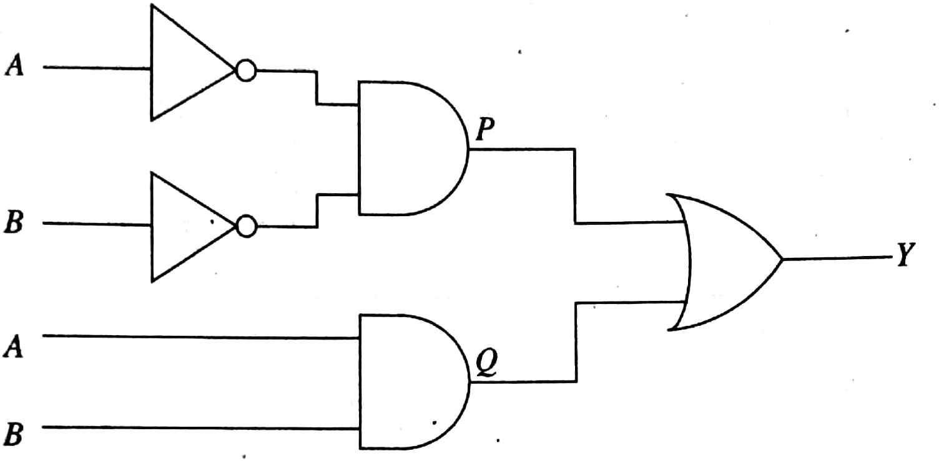
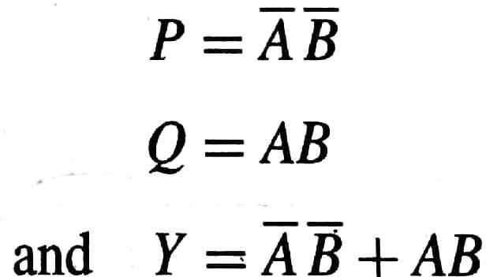
3. Write the boolean expression for the given logic diagram

Slide 96
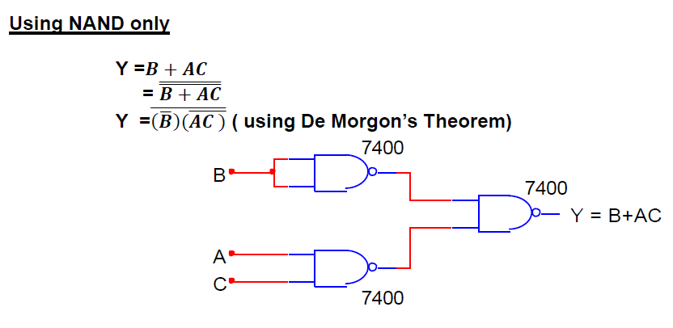
Simplifying Boolean expressions using NAND only and NOR only

Slide 97
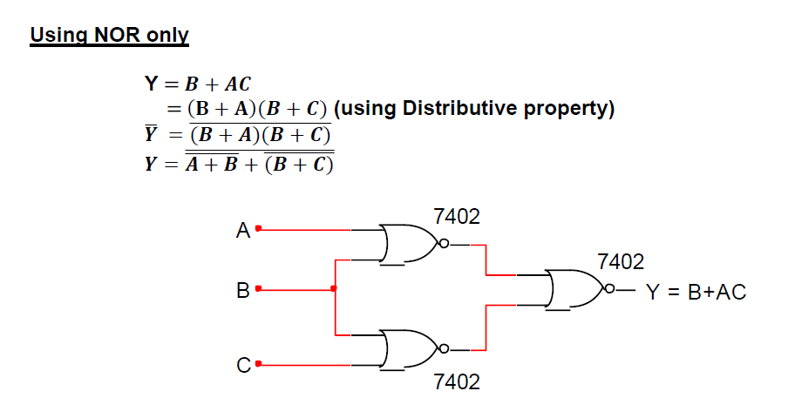

Slide 98
Definition of Combinational Logic
Combinational Logic deals with the techniques of “combining” the basic gates into circuits that performs some desired function.
Examples – Adders, Subtractors, Decoders. Encoders, Multipliers etc
Logic circuits without feedback from output to input.
Logic circuits that contain no memory

Slide 99
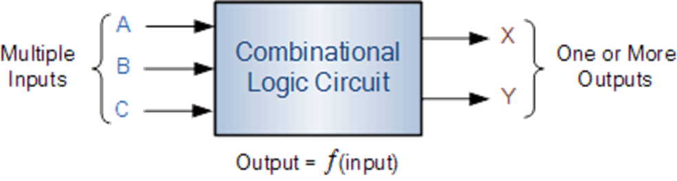

Slide 100
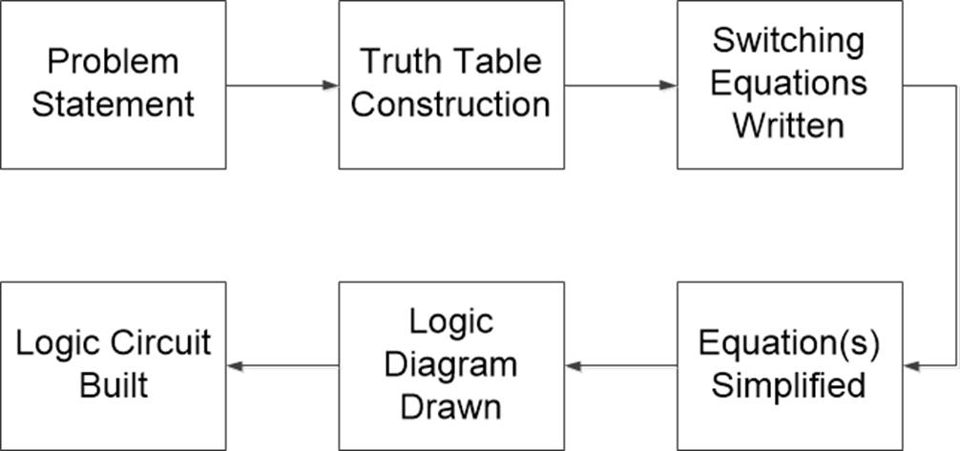
General Logic Design Sequence

Slide 101
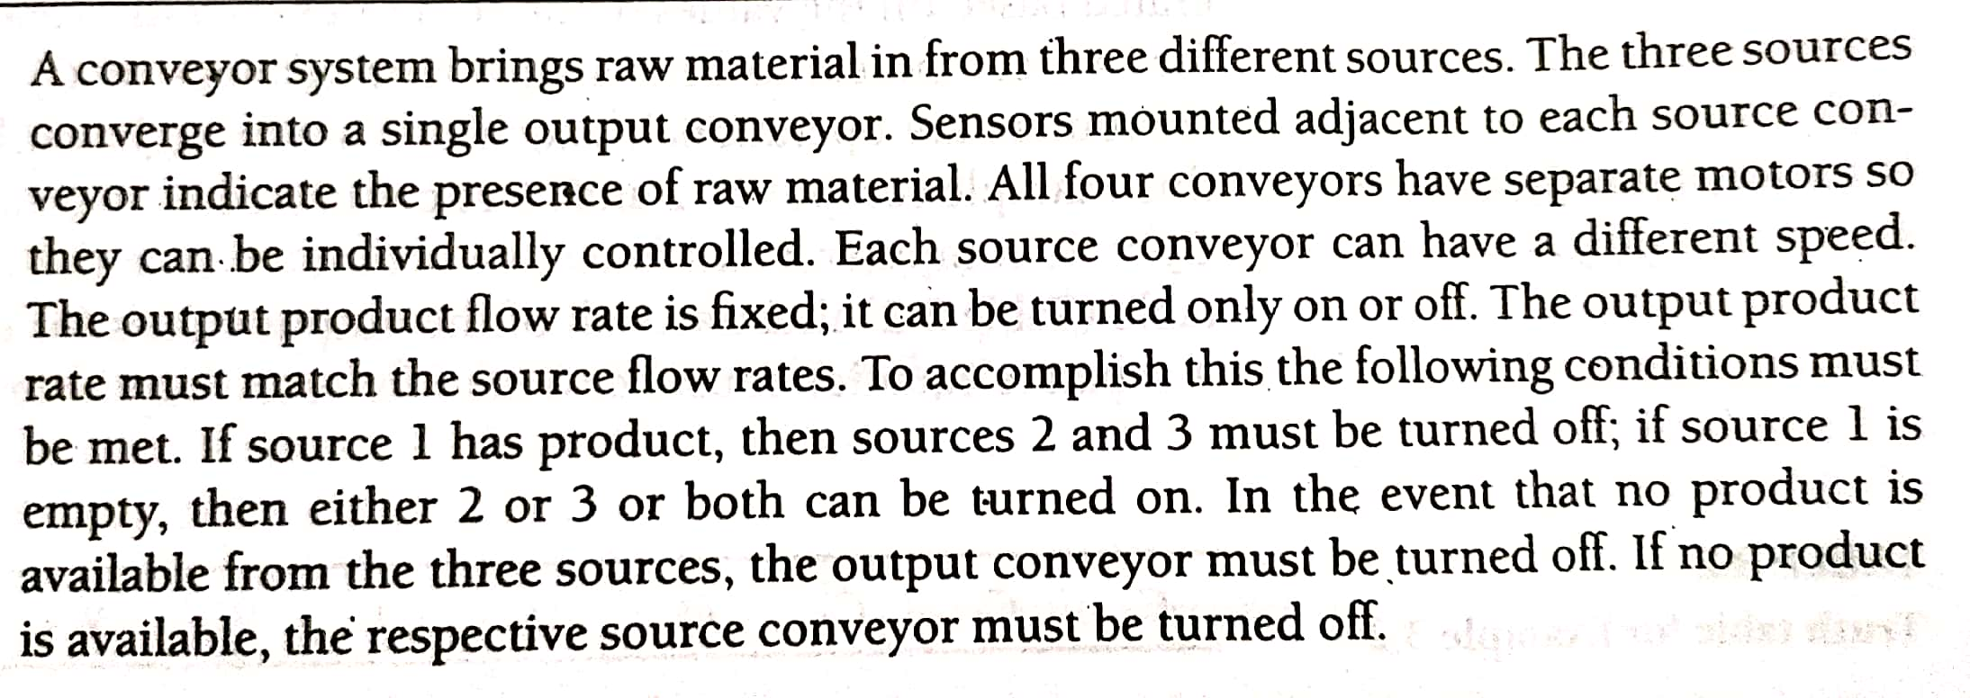
Problem statements to Truth Table

Slide 102
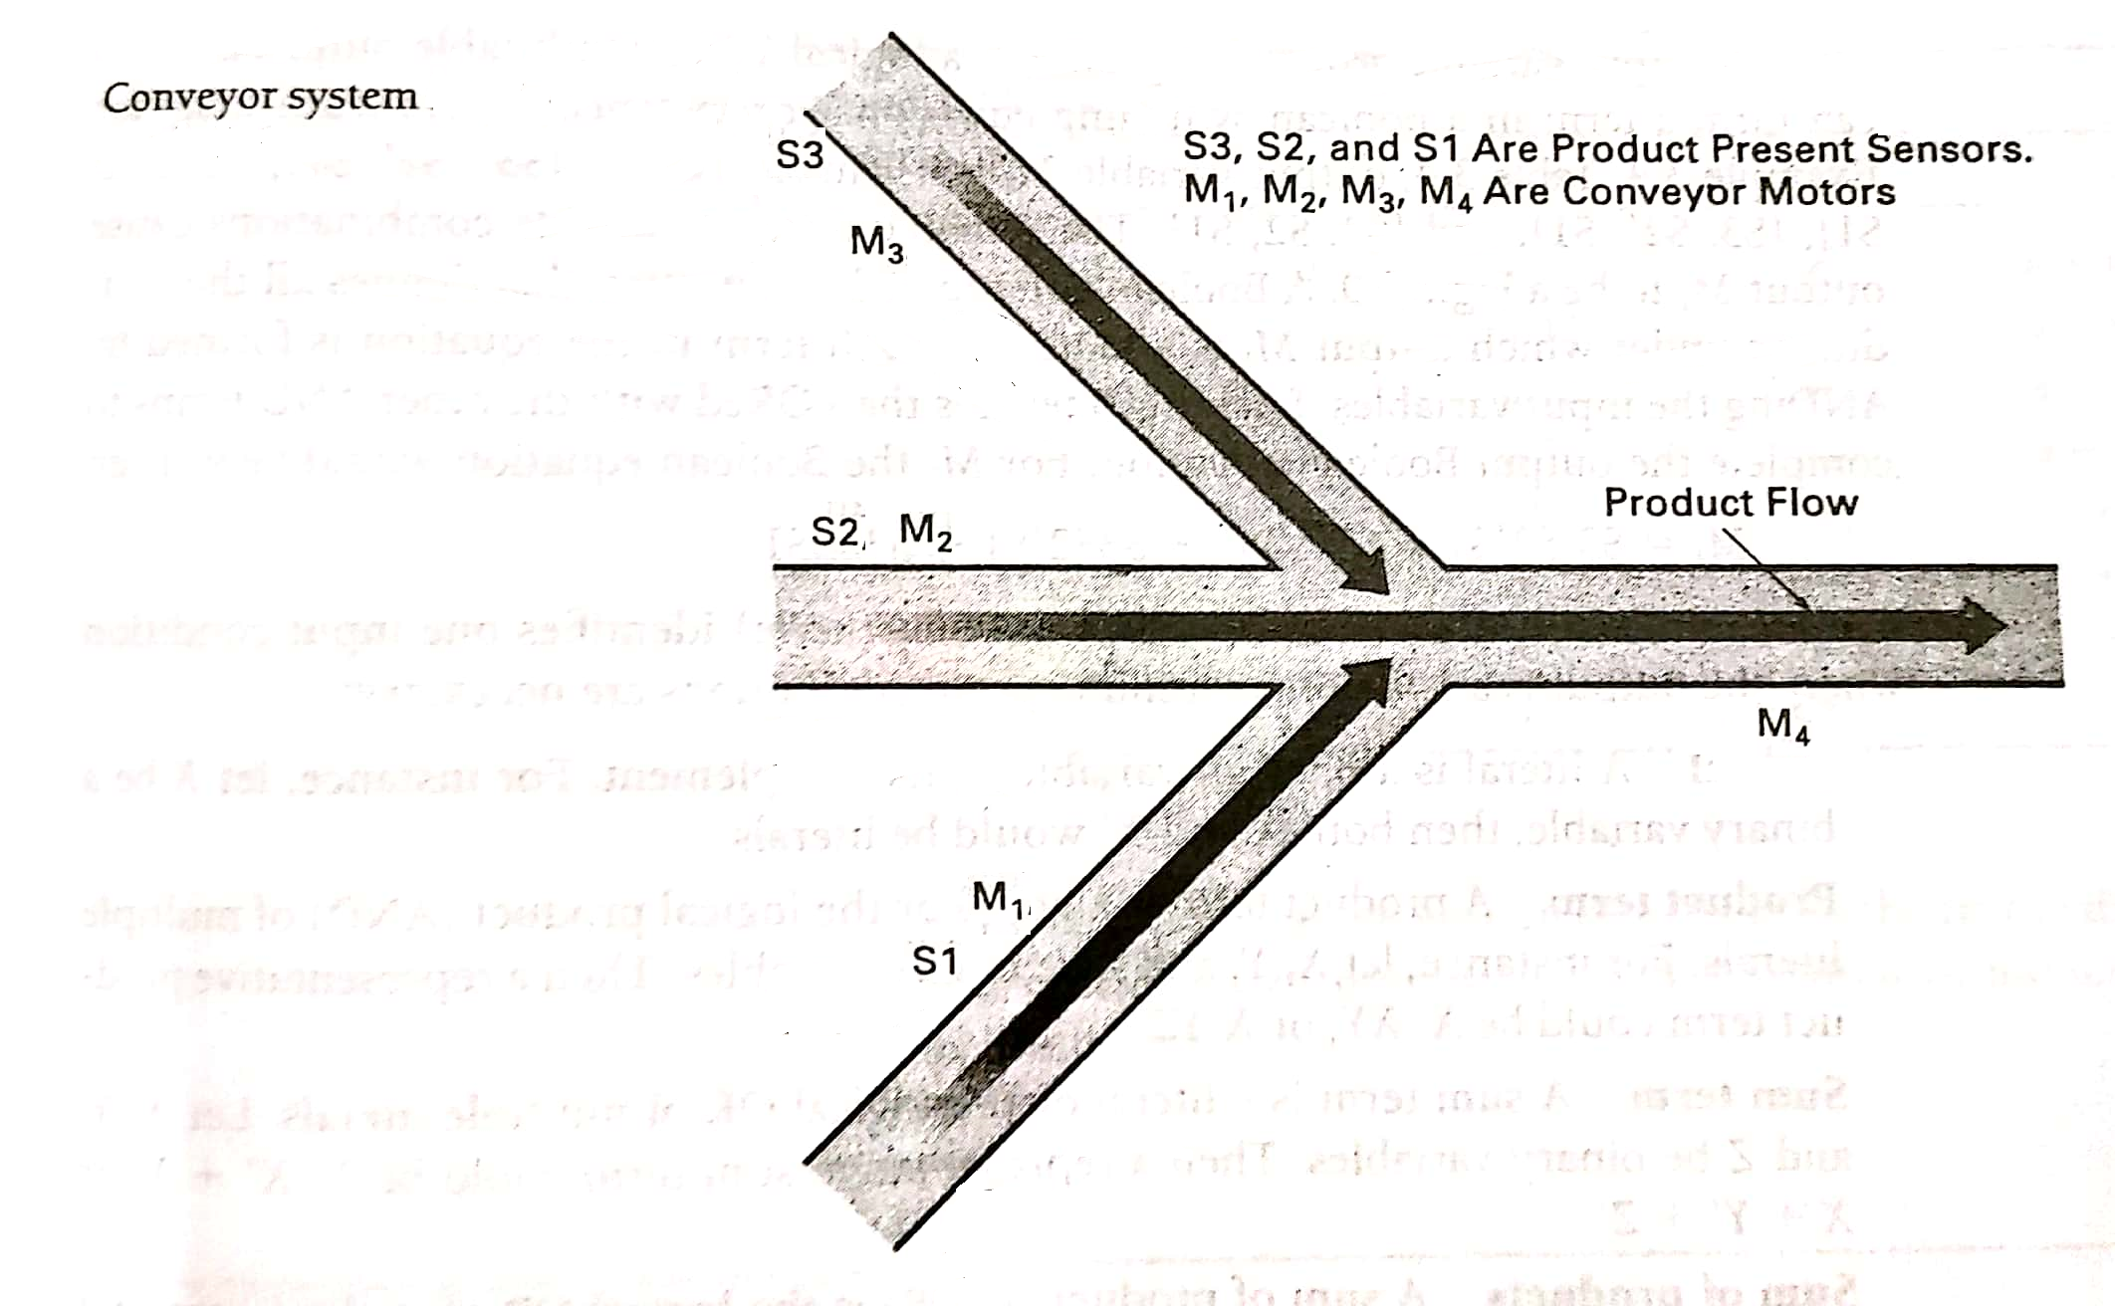

Slide 103
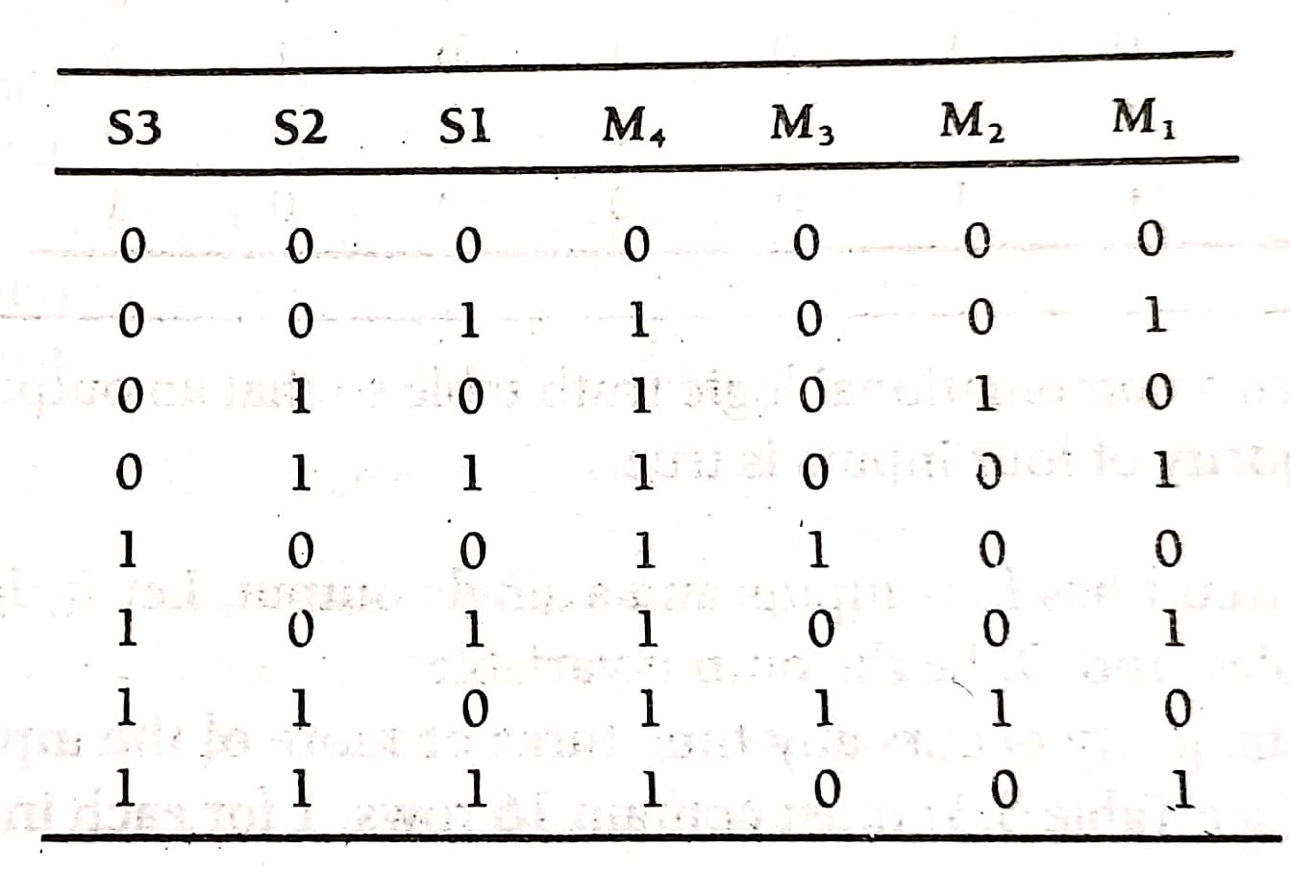

Slide 104
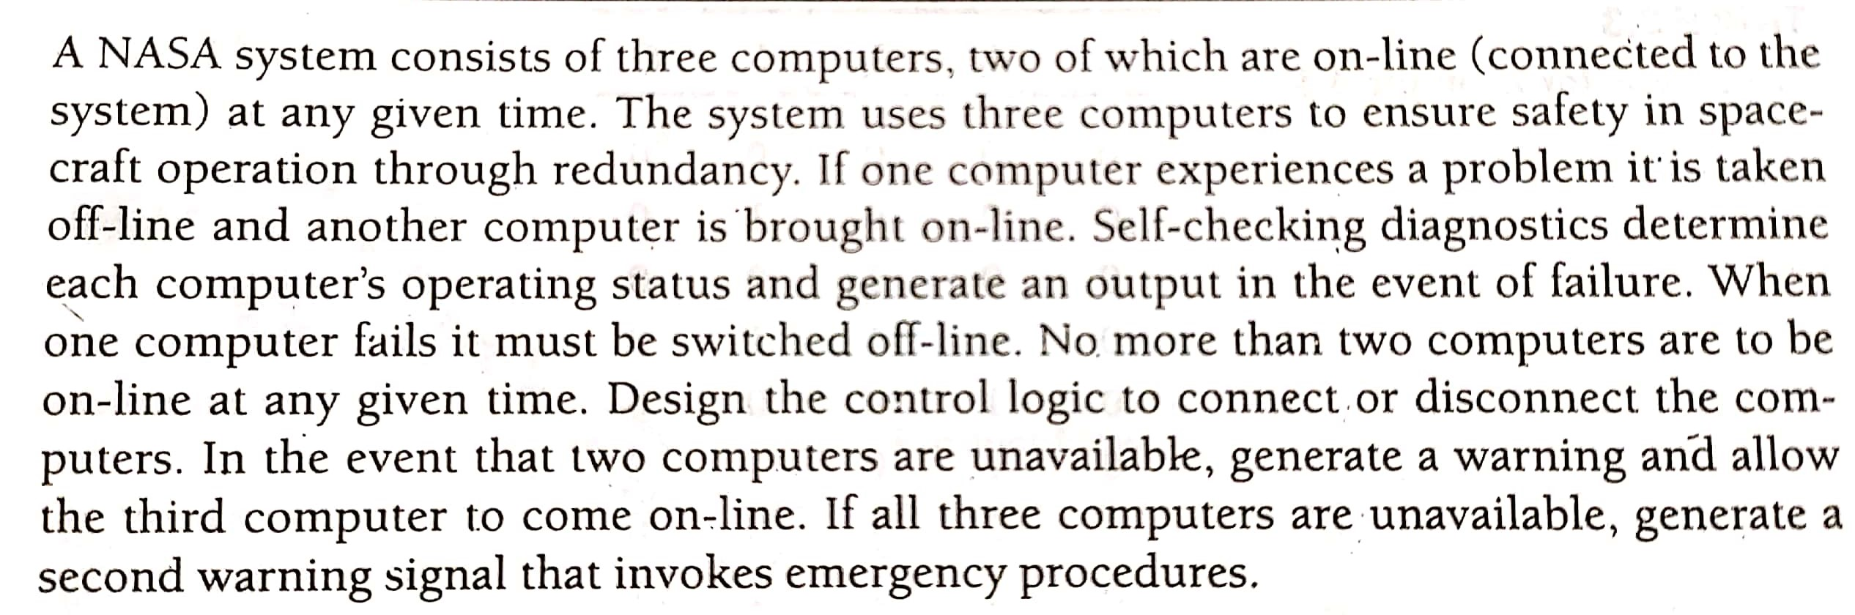

Slide 105
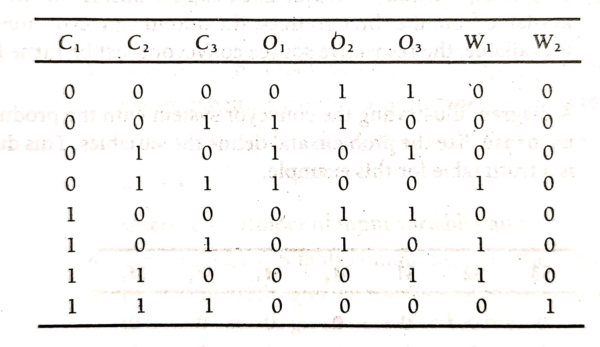

Slide 107
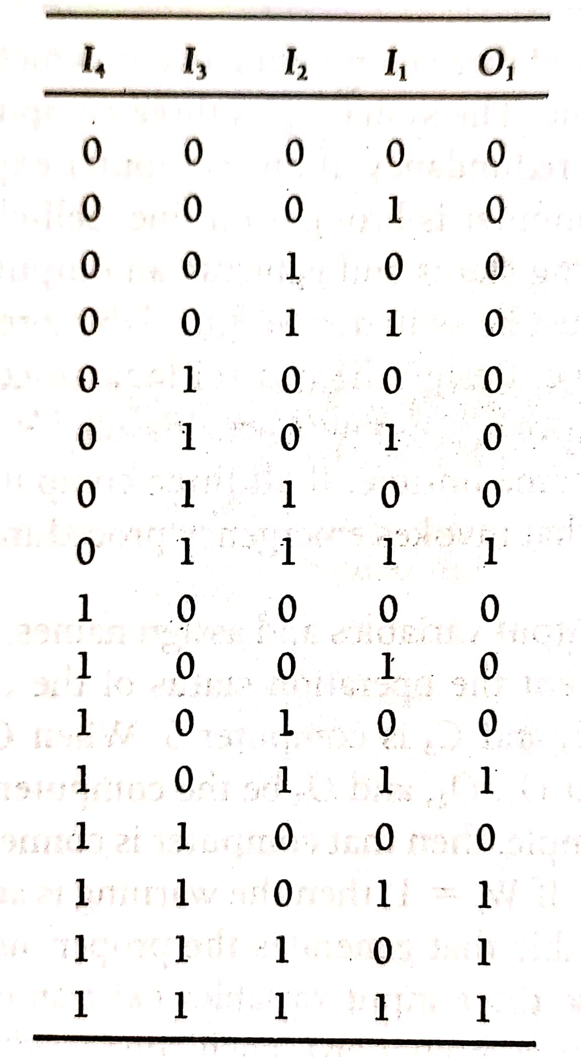

Slide 108
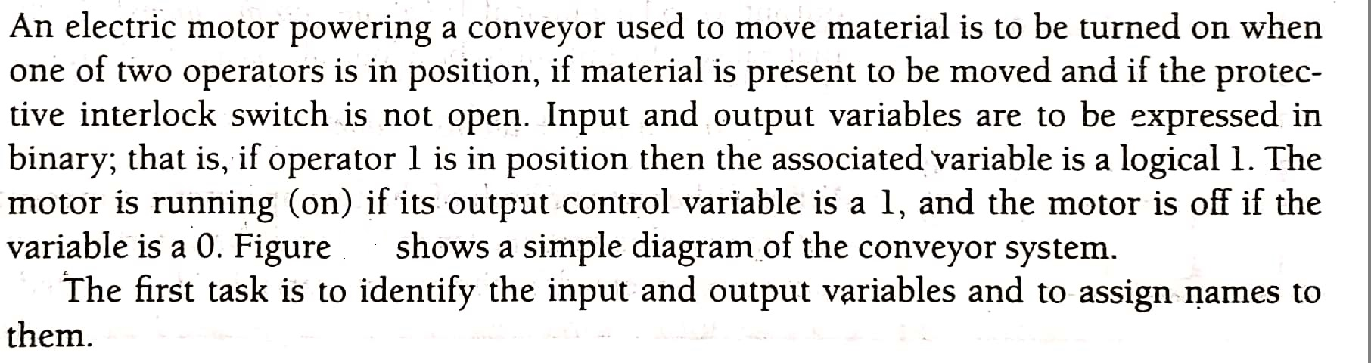

Slide 109
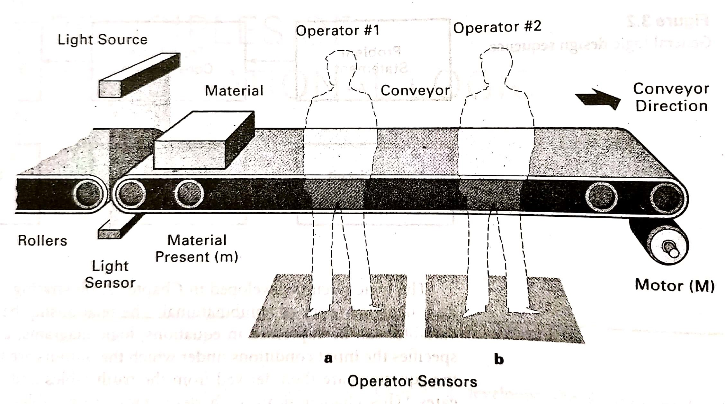

Slide 110
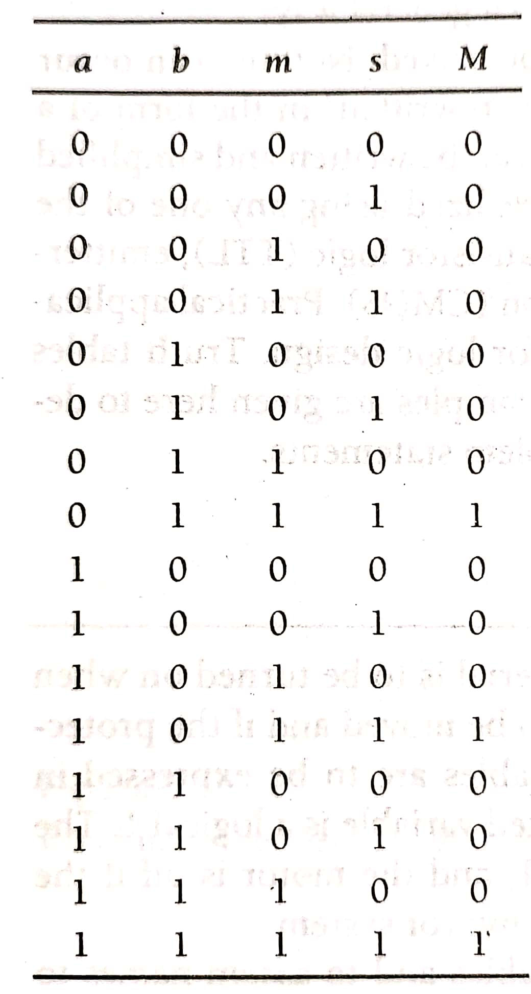

Slide 111
Design the combinational logic circuit which takes two, 2 bit numbers as its inputs and generates an output to indicate when the sum of the two numbers divisible by 3.

Slide 112
Design the combinational logic circuit which takes two, 2 bit numbers as its inputs and generates an output to indicate when the sum of the two numbers divisible by 3.
A1 | A2 | B1 | B2 | F | MINTERM
0 | 0 | 0 | 0 | 0
0 | 0 | 0 | 1 | 0
0 | 0 | 1 | 0 | 0 | ’
0 | 0 | 1 | 1 | 1 | A₁’ A₂’ B₁B₂
0 | 1 | 0 | 0 | 0
0 | 1 | 0 | 1 | 0
0 | 1 | 1 | 0 | 1 | A₁’A₂B₁B₂’
0 | 1 | 1 | 1 | 0
1 | 0 | 0 | 0 | 0
1 | 0 | 0 | 1 | 1 | A₁A₂’B₁’B₂
1 | 0 | 1 | 0 | 0
1 | 0 | 1 | 1 | 0
1 | 1 | 0 | 0 | 1 | A₁A₂B₁’B₂’
1 | 1 | 0 | 1 | 0
1 | 1 | 1 | 0 | 0
1 | 1 | 1 | 1 | 1 | A₁A₂B₁B₂

Slide 113
A₁’ A₂’ B₁B₂
F= A₁’A₂B₁B₂’ + A₁A₂’B₁’B₂ +A₁A₂B₁’B₂’ + A₁A₂B₁B₂

Slide 114
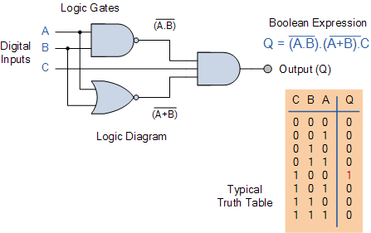
Combinational Logic Specification
Three ways
Logic Diagram: Graphical representation
Truth Table: A list that shows all the output states in tabular form for each possible combination of input variable.
Boolean Equations: Algebraic expression showing the operation of the logic circuit for each input variable.

Slide 115
Boolean Equations
Also known as Switching equations
A literal is a Boolean Variable or its complement (a, x’, z)
A product term is a literal or the logical product (AND) of multiple literals (ab, x’y, z’y’)
A sum term is a literal or the logical sum (OR) of multiple literals (a+b, a’+b, x’+y’)
A sum of product (SOP) is the logical OR of multiple product terms (ab+bc’+a’b’)
A product of sum (POS) is the logical AND of multiple sum terms[(a+b’)(a’+b’)(a’+b)]

Slide 116
Minterms
A minterm is a special product of literals, in which each input variable appears exactly once.
A function with n variables has 2^{n} minterms
Each minterm is true for exactly one combination of inputs
Minterm Is true when… Shorthand
x’y’z’ x=0, y=0, z=0 m₀
x’y’z x=0, y=0, z=1 m₁
x’yz’ x=0, y=1, z=0 m₂
x’yz x=0, y=1, z=1 m₃
xy’z’ x=1, y=0, z=0 m₄
xy’z x=1, y=0, z=1 m₅
xyz’ x=1, y=1, z=0 m₆
xyz x=1, y=1, z=1 m₇

Slide 117
Sum of Minterms
Sum of minterms expression can be written from the truth table by picking out the rows of the table where the function output is 1.
f = x’y’z’ + x’y’z + x’yz’ + x’yz + xyz’
= m₀ + m₁ + m₂ + m₃ + m₆
= Σm(0,1,2,3,6)
f’ = xy’z’ + xy’z + xyz
= m₄ + m₅ + m₇
= Σm(4,5,7)
f’ contains all the minterms not in f

Slide 118
Maxterms
A maxterm is a special sum of literals, in which each input variable appears exactly once.
A function with n variables has 2^{n} maxterms
Each maxterm is false for exactly one combination of inputs
Maxterm Is false when… Shorthand
x + y + z x=0, y=0, z=0 M₀
x + y + z’ x=0, y=0, z=1 M₁
x + y’ + z x=0, y=1, z=0 M₂
x + y’ + z’ x=0, y=1, z=1 M₃
x’ + y + z x=1, y=0, z=0 M₄
x’ + y + z’ x=1, y=0, z=1 M₅
x’ + y’ + z x=1, y=1, z=0 M₆
x’ + y’ + z’ x=1, y=1, z=1 M₇

Slide 119
Product of Maxterms
Product of maxterms expression can be by picking out the rows of the table where the function output is 0.
f = (x’ + y + z)(x’ + y + z’)(x’ + y’ + z’)
= M₄ M₅ M₇
= ∏M(4,5,7)
f’ = (x + y + z)(x + y + z’)(x + y’ + z)
(x + y’ + z’)(x’ + y’ + z)
= M₀ M₁ M₂ M₃ M₆
= ∏M(0,1,2,3,6)
f’ contains all the maxterms not in f

Slide 120
Relation of Minterm to Maxterm
Any minterm m_{i} is the complement of the corresponding maxterm M_{i}
Minterm Shorthand
x’y’z’ m₀
x’y’z m₁
x’yz’ m₂
x’yz m₃
xy’z’ m₄
xy’z m₅
xyz’ m₆
xyz m₇
Maxterm Shorthand
x + y + z M₀
x + y + z’ M₁
x + y’ + z M₂
x + y’ + z M₃
x’ + y + z M₄
x’ + y + z’ M₅
x’ + y’ + z M₆
x’ + y’ + z’ M₇

Slide 121
Canonical Forms
A Canonical form of a switching equation is one that contains all of the available input variables.
Canonical Sum of Products: It is a complete set of Minterms that defines when an output is a logical 1
Canonical Product of sums: It is a complete set of maxterms that defines when an output is a logical 0
Canonical expressions are not simplified and contains redundancies.
f = x’y’ + x’y + xyz’ is a normal expression
x’y’z’ + x’y’z + x’yz’ + x’yz + xyz’ is the canonical form

Slide 122
Conversion to Canonical Form
SOP to canonical:
Identify the missing variable in each AND term
AND the missing term and its complement with the original AND term
Expand the term by distribution property
POS to canonical:
Identify the missing variable in each OR term
OR the missing term and its complement with the original OR term
Expand the term by distribution property

Slide 123
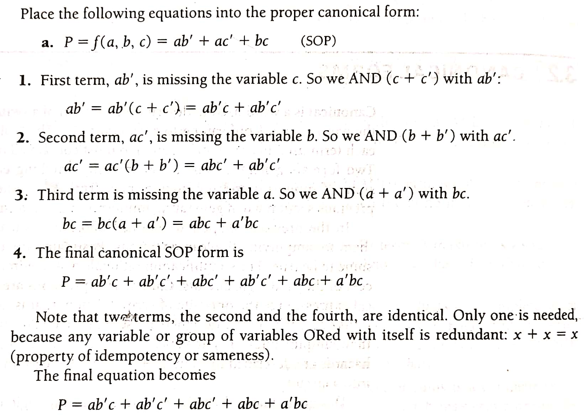

Slide 124
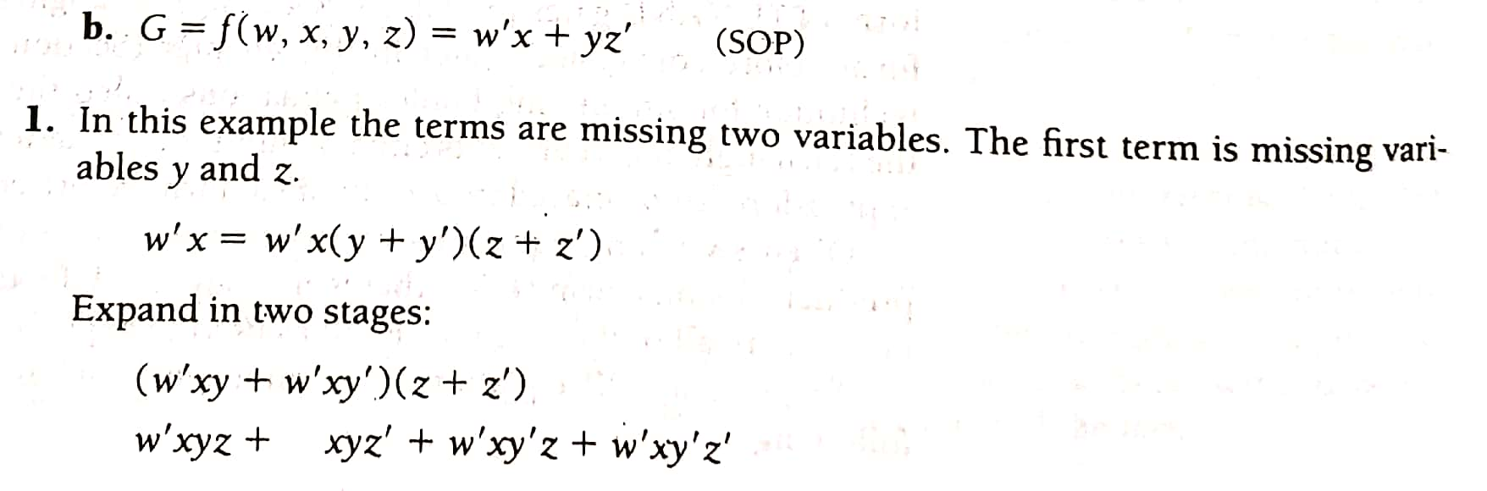
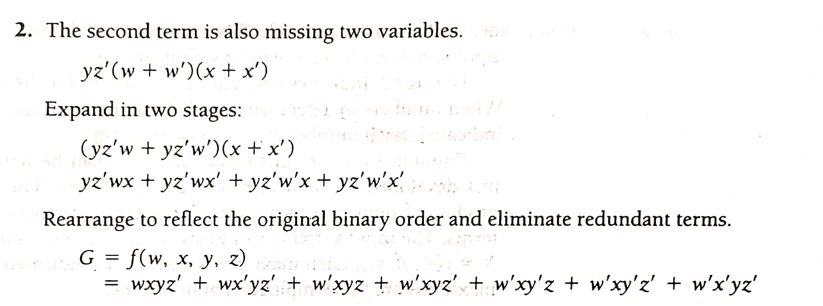

Slide 125
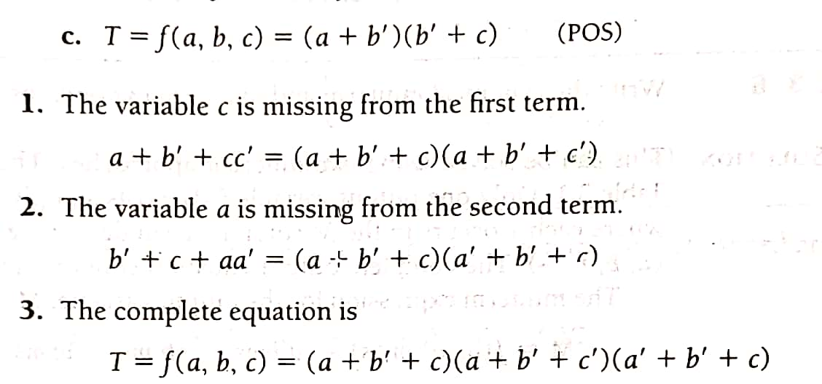

Slide 126
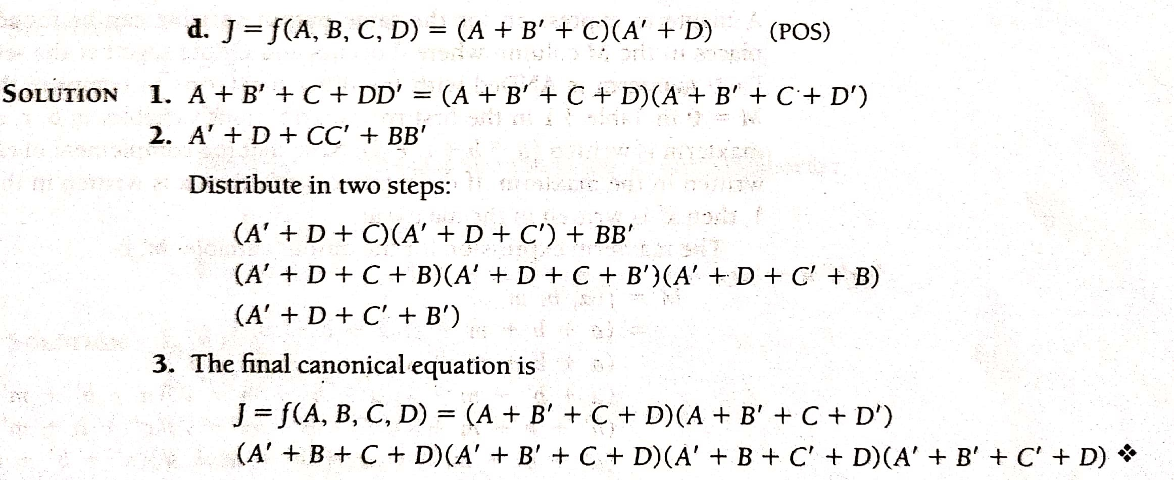

Slide 127
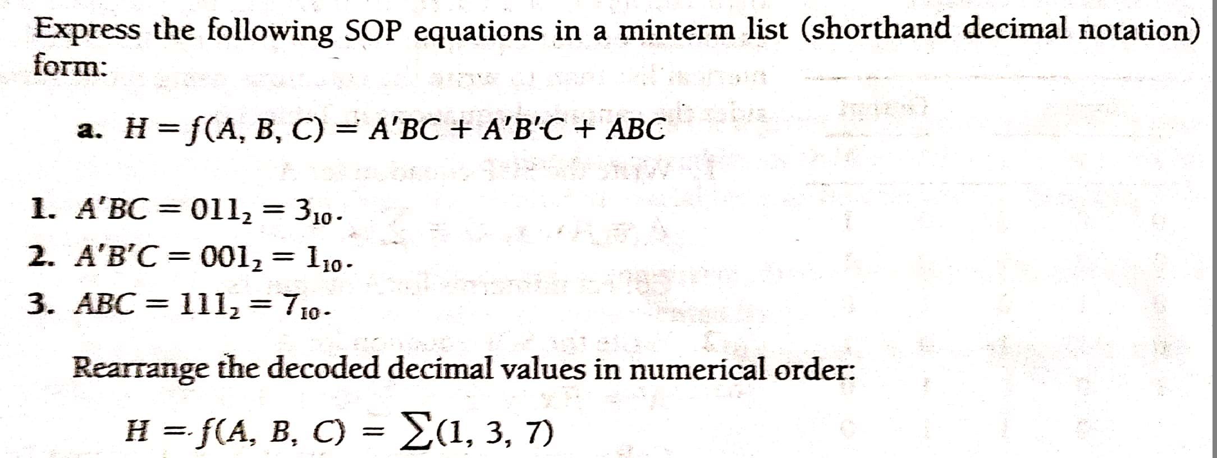

Slide 128
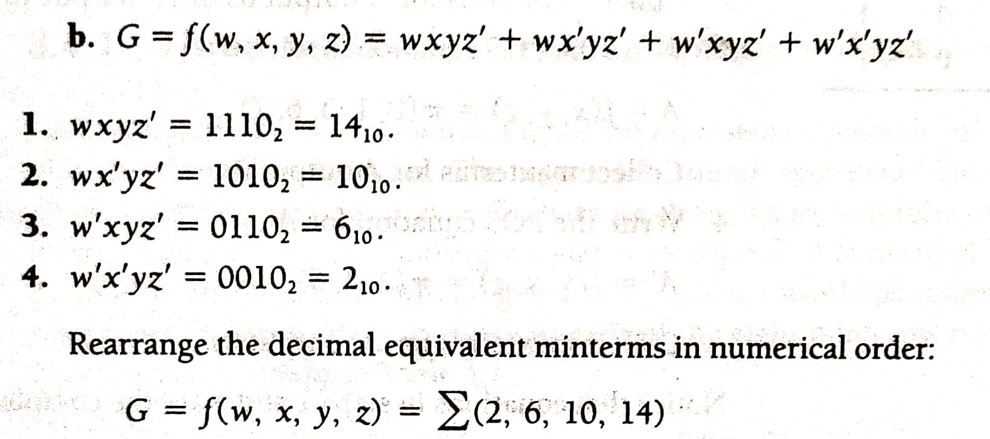

Slide 130



Slide 131


Slide 132


Slide 133


Slide 134


Slide 135


Slide 136


Slide 137


Slide 138


Slide 139


Slide 140


Slide 141


Slide 142


Slide 143


Slide 144



Slide 145


Slide 146


Slide 147

Prime Implicants and Essential Prime Implicants
Minimal Sum = x’z’ + yz

Slide 148

Minimal Sum = z’

Slide 149

Find the PI and EPI. Also find the minimal SUM

Slide 150


Slide 151

Minimal sum obtained

Slide 152


Slide 153


Slide 154


Slide 155


Slide 156


Slide 157


Slide 158


Slide 159

BCD to Excess-3 Conversion

Slide 160


Slide 161


Slide 162

W=A+BC+BD=A+B(C+D)
X=B’C+B’D+BC’D’=B’(C+D)+BC’D’
Y=CD+C’D’
Z=D’

Slide 163

Logic Diagram

Slide 164
J = f (x,y,z) = ∏ (0,3,4,7)
Show the grouping of Maxterms. Mention Prime Implicates and Essential prime implicates. Also Find the Minimal Product .

Slide 165


Minimal Product

Slide 166



Slide 167


Minimal Product

Slide 168
Quine-McCluskey Tabular Method
simplify the following Boolean function, f(W,X,Y,Z)=∑m(2,6,8,9,10,11,14,15) using Quine-McClukey tabular method.

Slide 169


Slide 170


Slide 171



Slide 172



Slide 173
End of Unit1

